Slide 1
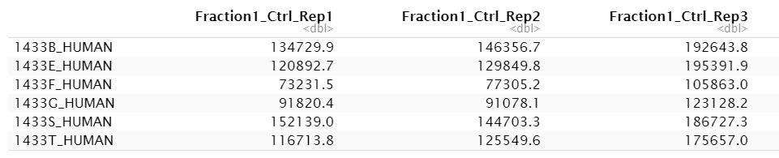
The data set
3 replicates with control sample
+ 3 replicates with RNase sample
separated into 25 fractions
→ 3*3*25 = 150 columns
rows = proteins (7086)
Amount of protein in fraction 1 of replicate 1 with control sample
EINHEIT???

Slide 2
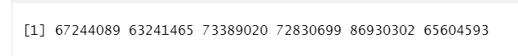
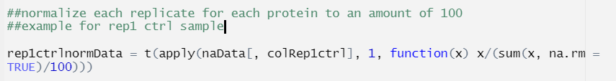

Statistical properties
every 6th measurement is part of one replicate
Different amounts of protein in replicates
many zeros

Slide 3
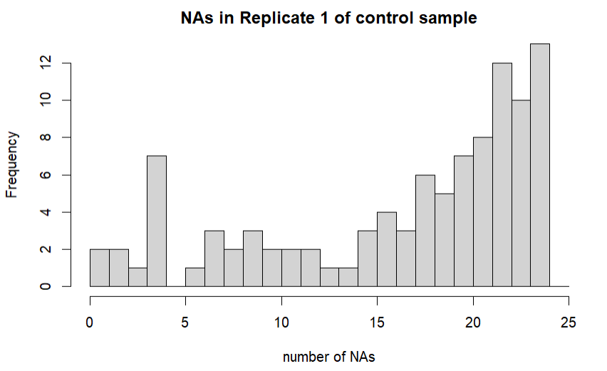
Statistical properties
Drop protein if it has more than 10 zeros in at least two replicates in control and/or Rnase sample

Slide 4
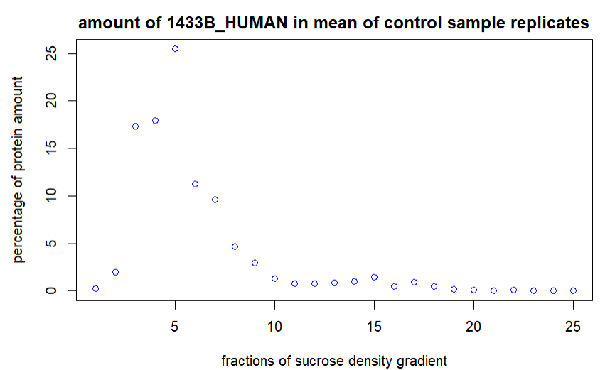
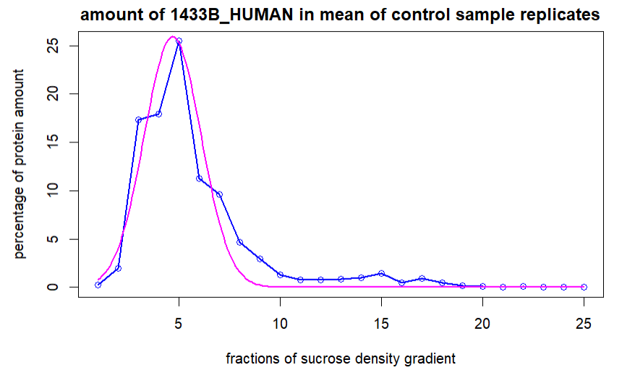
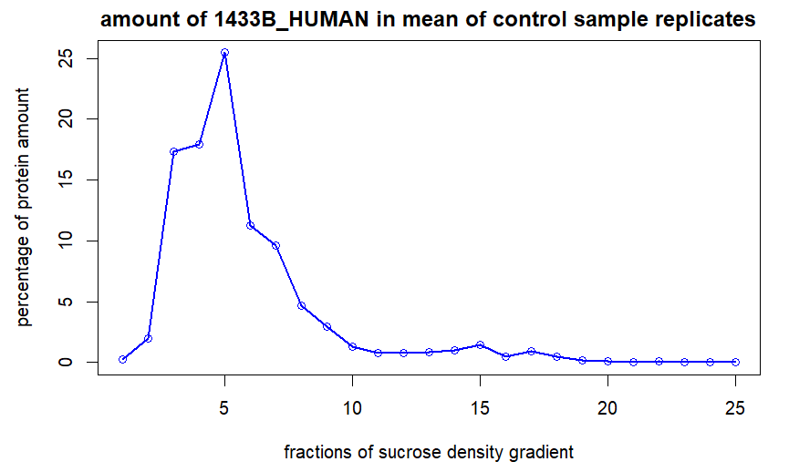
Normalization, Gaussian approximation

Slide 5
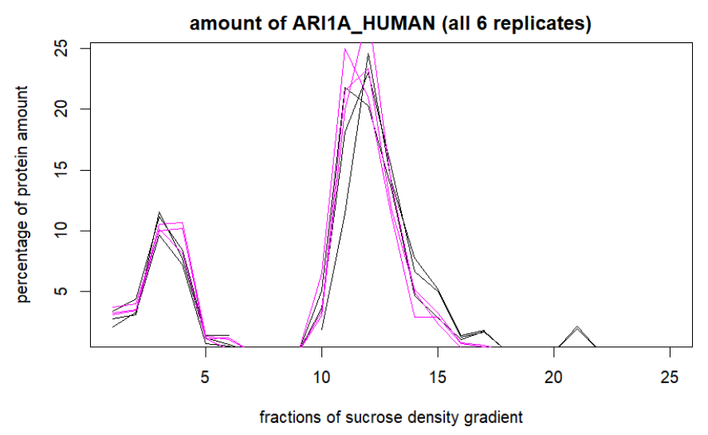
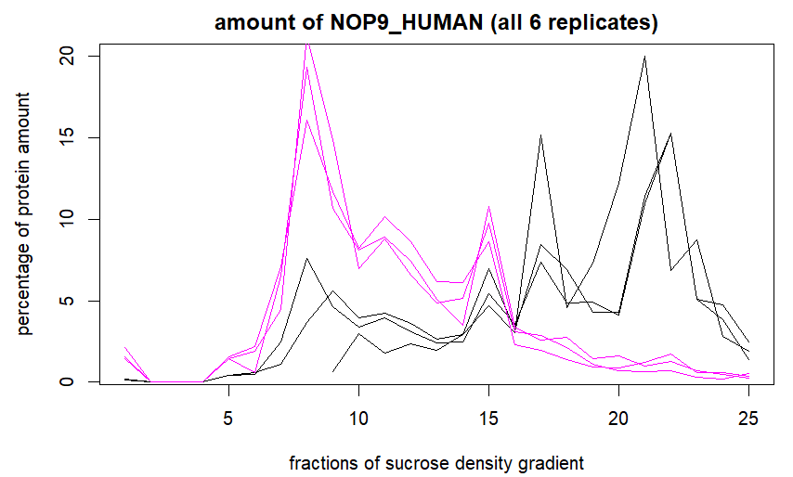
Shift between the fractions
Control = black
RNase = magenta

Slide 6
Team organisation
at least one meeting per week
Where are we in the project
Presenting what team members achieved
Open questions
Meeting after Tutorium
Assignment of tasks
Teams of two for more difficult/complex tasks

